Slide 1
Standard Distribution Curve – Confidence Interval

Slide 2
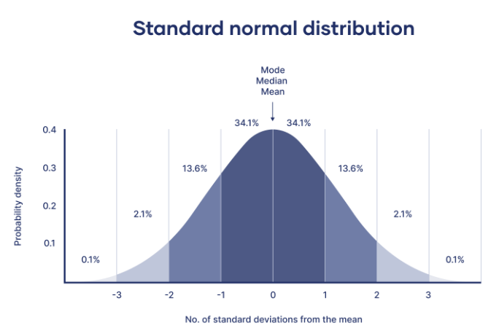
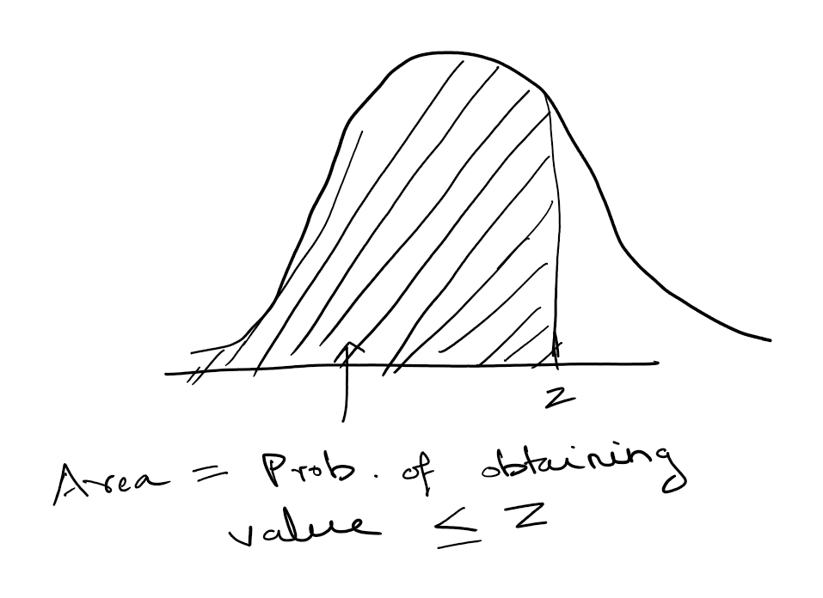
standard normal distribution curve (p1):
The standard normal distribution is a normal distribution with a mean of 0 and a standard deviation of 1.
Shape: The standard normal distribution curve is bell-shaped and symmetric about the mean. This symmetry means that the left half of the curve is a mirror image of the right half.
Empirical Rule
About 68% of data falls within 1 standard deviation (σ).
About 95% within 2σ.
About 99.7% within 3σ.
3. Area Under the Curve: The total area under the standard normal distribution curve is equal to 1. The area to the left of a Z-score represents the cumulative probability of that Z-score.
4. Applications: The standard normal distribution is widely used in statistics, particularly in hypothesis testing, confidence intervals, and in the calculation of probabilities for normally distributed data.
5. Transformation: Any normal distribution can be transformed into a standard normal distribution using Z-scores, allowing for easier comparison and analysis.

Slide 3
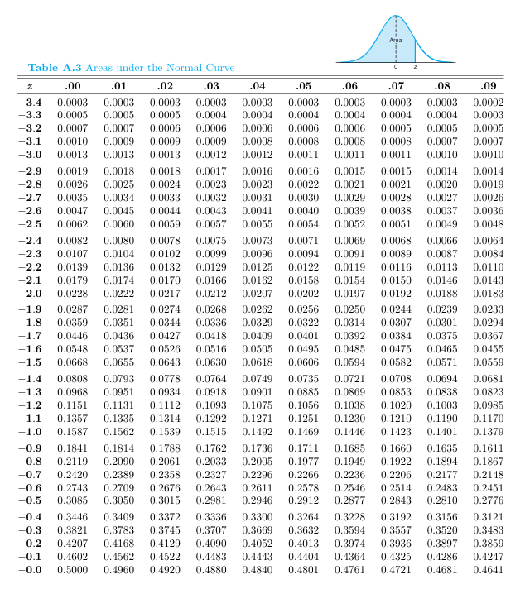
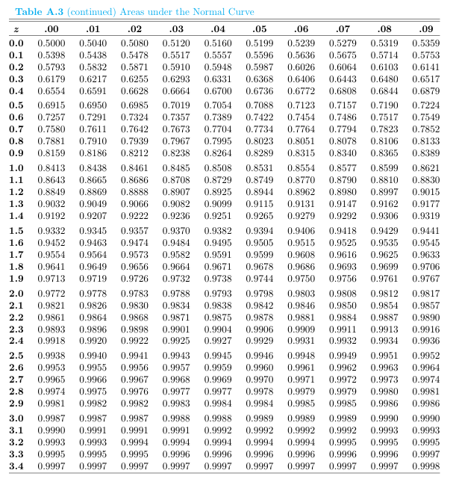
Area under z = 2.09 is 0.9817

Slide 4






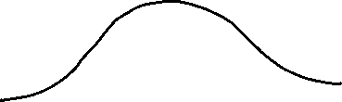

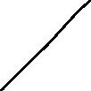




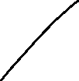





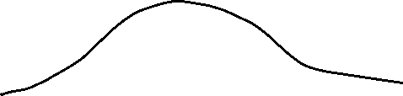
Area under standard normal distribution curve (p1): 1) Find the area under the standard normal distribution curve to the left of z= 2.09. Answer: Using Std normal distribution table, it is 0.9817. INTERPRETATION1: 98.17% represents the prob. that measured value would be < 2.09… Also written as P( z < 2.09) = 0.9817 INTERPRETATION2: 98.17% of data has value < 2.09….
2) Find the area under the standard normal distribution curve to the right of z= 2.09. Answer = P( z > 2.09 ) = 1 - 0.9817 = 0.0183…
INTERPRETATION1: 1.83% represents the prob. that measured value would be > 2.09… Also written as P( z > 2.09) = 0.0183 INTERPRETATION2: 1.83% of data has value > 2.09….

Slide 5






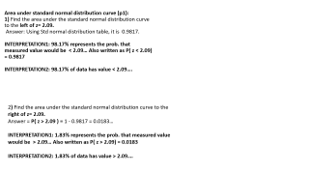

Area under standard distribution curve (p1): Find the area under the standard normal distribution curve between z = 1.62 and z = -1.35. Answer: 0.9474 - 0.0885 = 0.8589….interpretation: P( -1.35 < z < 1.62 ) = 0. 8589

Slide 6
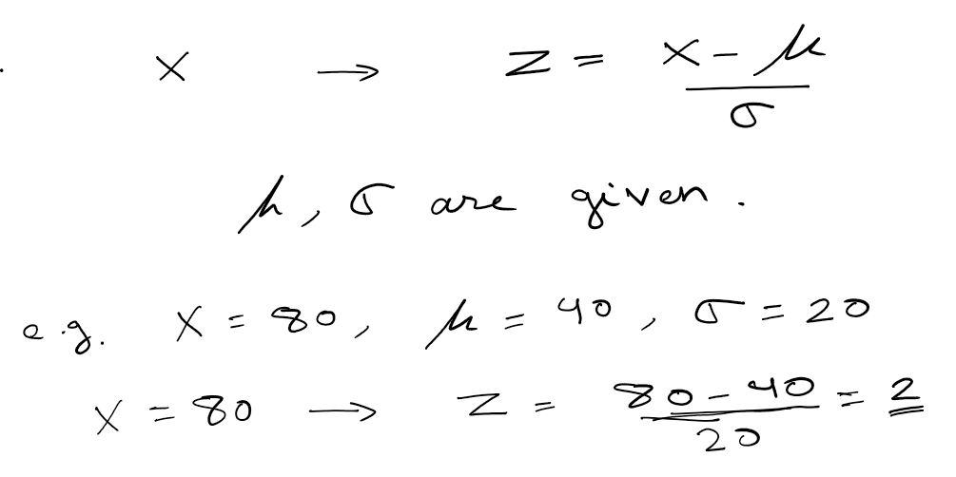
Convert a normal random variable value to standard normal value z:

Slide 7
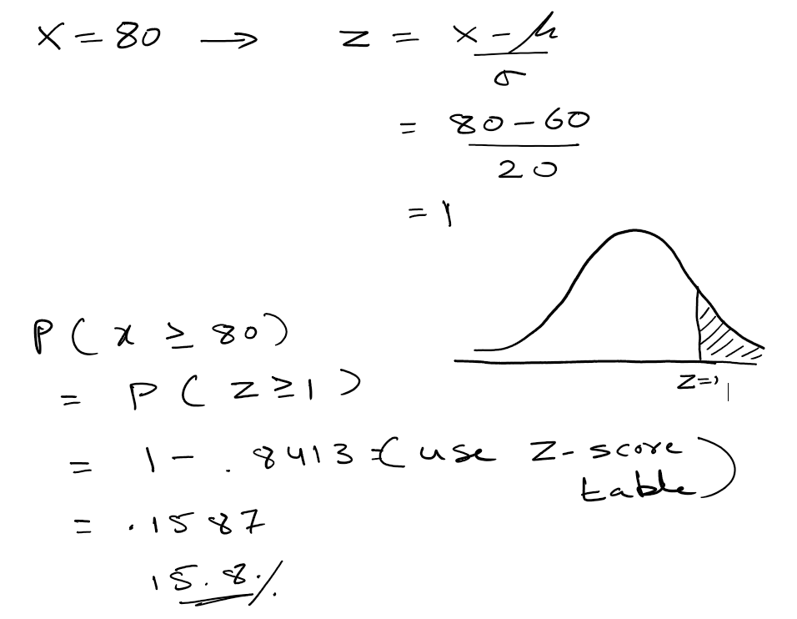
Application of standard normal table:
The annual rainfall at a particular geographical location is modeled as normal random variable with a mean of 60 cm and std dev of 20 cm. What is the probability that this year the average rainfall will be at least 80 cm?
Solution: First we convert normal RV to standard RV.

Slide 8
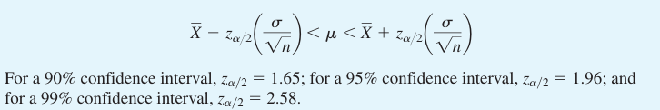
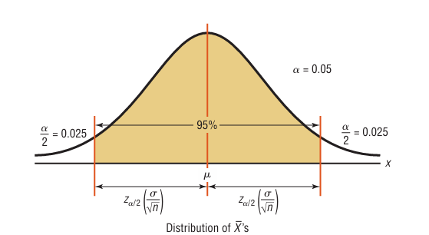
The confidence level of an interval estimate of a parameter is the probability that the interval estimate will contain the parameter, assuming that a large number of samples are selected and that the estimation process on the same parameter is repeated.
A confidence interval is a specific interval estimate of a parameter determined by using data obtained from a sample and by using the specific confidence level of the estimate.
Three common confidence intervals: the 90%, the 95%, and the 99% confidence intervals
NOTE: confidence interval is also specified as 100(1-α)%.
So, 100(1-α) = 95 ⬄ α=0.05
Formula for the Confidence Interval of the Mean for specified α when σ is known
Term $z\left(\frac{σ}{\sqrt{n}}\right)$ is called the margin of error (AKA maximum error of the estimate).
When σ is known and the sample size >= 30 , or the population is normally distributed if the sample size is less than 30, the confidence interval for the mean can be found by using the z distribution.

Slide 9
How to calculate z from given α ?
Easy answer: Use AI tools or use any online tool
Common ones: α = 0.05 => z= TODO
B) Calculate Z for α = 0.05: From table:

Slide 10
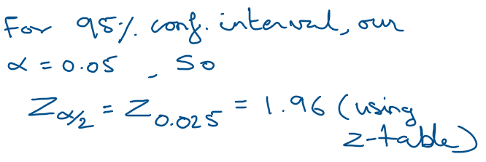
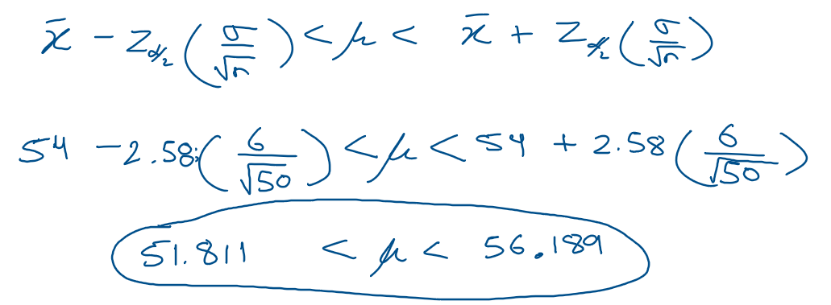
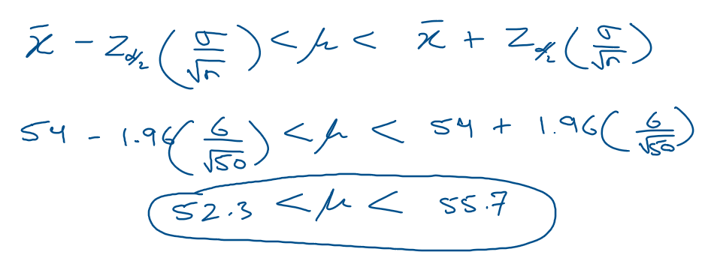
1) Engineering Measurement Problem ( z- value) : A quality control engineer wants to estimate the average time (in days) required to calibrate and certify a batch of precision measurement instruments in a laboratory. A random sample of 50 instruments showed an average calibration time of 54 days. Assume the population standard deviation is 6.0 days.
Find the best point estimate of the population mean calibration time.
Find the 95% confidence interval for the population mean calibration time.
Find the 99% confidence interval for the population mean calibration time.
A) The best point estimate of the population mean is 54 days.
C) For the 99% confidence interval (i.e. α=0.01). So the z (for α/2 = 0.005 ) = 2.58 (using z-table)
B) NOTE: we use z and not t table because the sample size, n > 30)
So, one can say with 99% confidence that the interval between 51.811 and 56.189 days does contain the population mean, based on a sample of 50 automobiles.
So, one can say with 95% confidence that the interval between 52.3 and 55.7 days does contain the population mean, based on a sample of 50.
(See next slide on how to solve it programmatically…cont….)

Slide 11
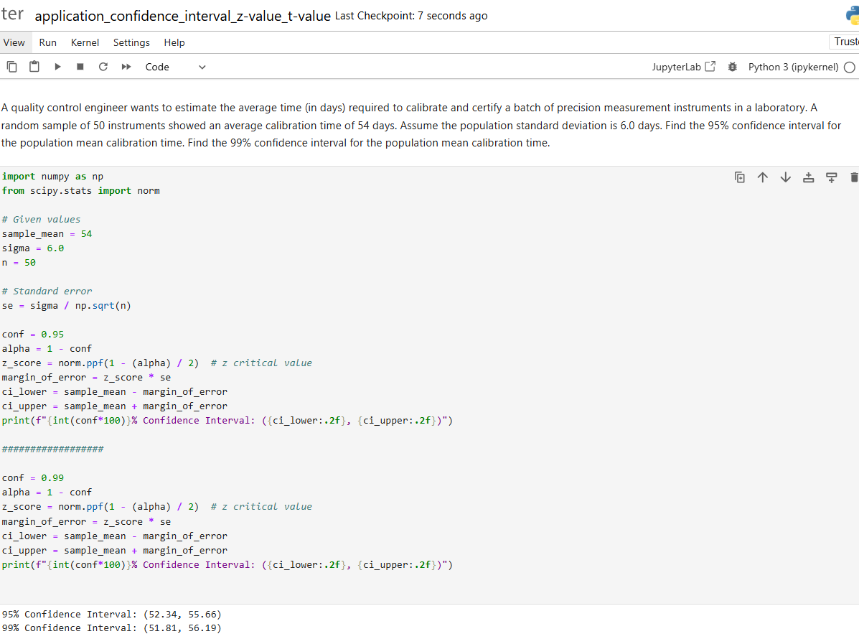

Slide 12
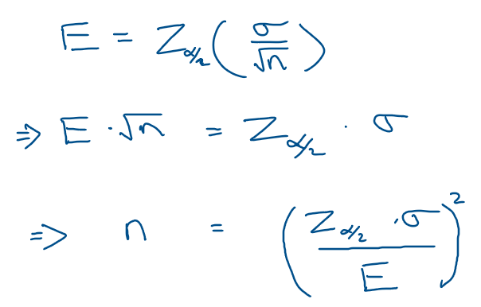
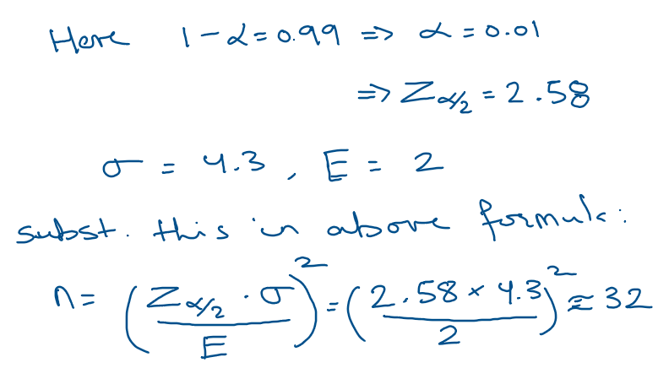
How large a sample is necessary to make an accurate estimate ?
Answer depends on three factors: the margin of error, the population standard deviation, and the degree of confidence.
We can derive the formula for sample size n from margin of error E as follows:
Example: An aerospace engineer is estimating the average fuel consumption rate of an aircraft engine during cruise conditions. For flight planning and performance certification, the engineer needs 99% confidence that the estimate is within 2 gallons per hour of the true mean consumption rate. Flight test data shows a standard deviation of 4.3 gallons per hour. How many minimum samples he needs?
To be 99% confident that the estimate is within 2 units of the true mean, the engineer needs a sample of at least 32 measurements.
(See next slide on how to solve it programmatically…cont….)

Slide 13
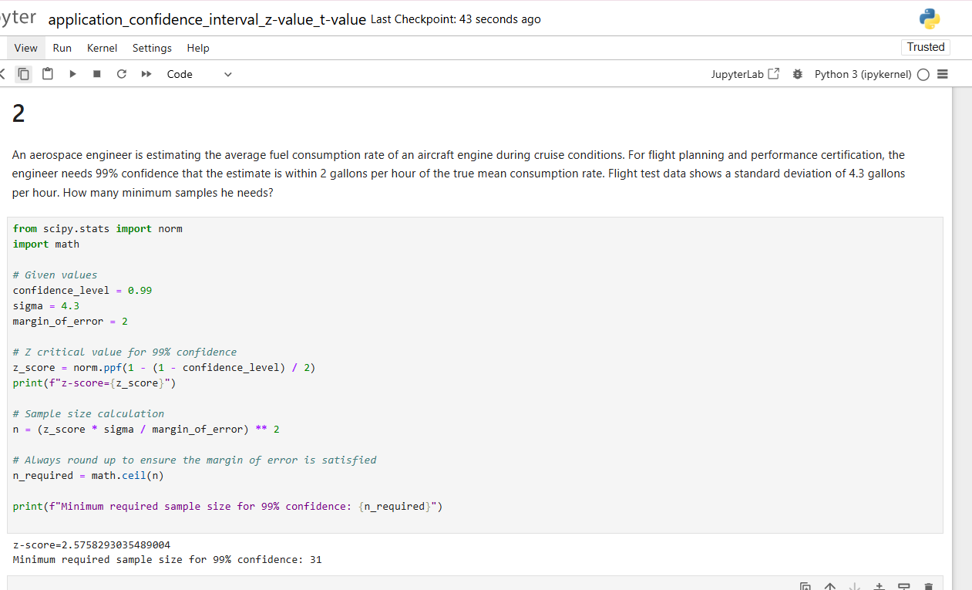

Slide 14
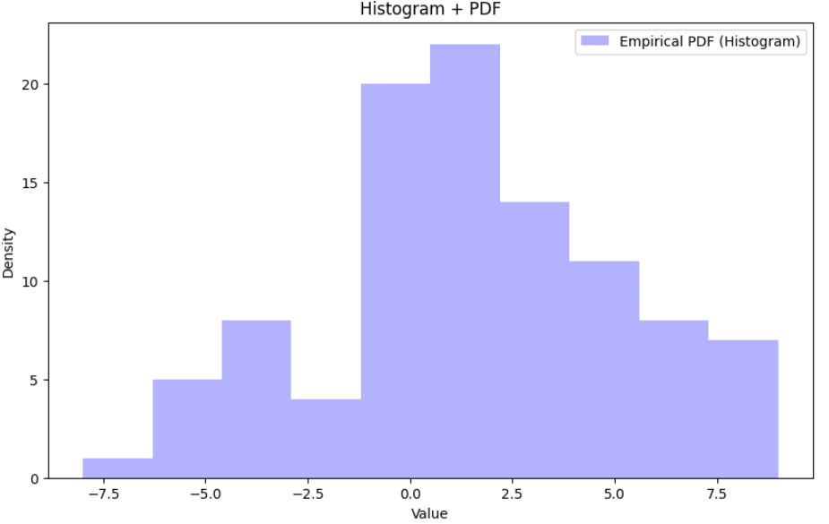

Determining Normality: A normally shaped or bell-shaped distribution is only one of many shapes that a distribution can assume; however, it is very important since many statistical methods require that the distribution of values be normally or approximately normally shaped.
We can use following to check for normality.
Method1) Draw a histogram for the data and check its shape. If the histogram is not approximately bell shaped, then the data are not normally distributed.
Method2) Skewness can be checked by using the Pearson coefficient (PC) of skewness also called Pearson’s index of skewness:
Formula = 3(Mean - Median) / Standard Deviation
If the index is greater than or equal to 1 or less than or equal to -1, it can be concluded that the data are significantly skewed.
confidential
$$\frac{3\left[\overline{x}−mⅇdian\right]}{s}$$
Problem: I have 100 temp. data of a city given in sorted order. Determine if its skewed. [-8 -6 -6 -6 -5 -5 -4 -4 -4 -4 -3 -3 -3 -3 -2 -2 -2 -2 -1 -1 -1 -1 -1 -1 0 0 0 0 0 0 0 0 0 0 0 0 0 0 1 1 1 1 1 1 1 1 1 1 1 1 2 2 2 2 2 2 2 2 2 2 3 3 3 3 3 3 3 3 3 3 3 3 3 3 4 4 4 4 4 5 5 5 5 5 5 6 6 6 6 6 6 6 7 8 8 8 8 8 8 9] (Hint: Create 10 bins for histogram)
Answer: Method1: Since I am creating 10 bins, so size of each bin = (|-8| + 9)/10 = 1.7 . We get following bin ranges with their corresponding counts:
Bin 1: Range [-8.0, -6.3) - Count: 1
Bin 2: Range [-6.3, -4.6) - Count: 5
Bin 3: Range [-4.6, -2.9) - Count: 8
Bin 4: Range [-2.9, -1.2) - Count: 4
Bin 5: Range [-1.2, 0.5) - Count: 20
Bin 6: Range [0.5, 2.2) - Count: 22
Bin 7: Range [2.2, 3.9) - Count: 14
Bin 8: Range [3.9, 5.6) - Count: 11
Bin 9: Range [5.6, 7.3) - Count: 8
Bin 10: Range [7.3, 9.0) - Count: 7
Visually it looks like normal distribution.
Method2) Here sample mean = 1.52, median = 1.5 and std_dev (s) = 3.59.
Using above formula, PC of skewness = 3*(1.52-1.5)/3.59 =0.016
It is not greater than or equal to 1 or less than or equal to -1, so it is normal distribution

Slide 15
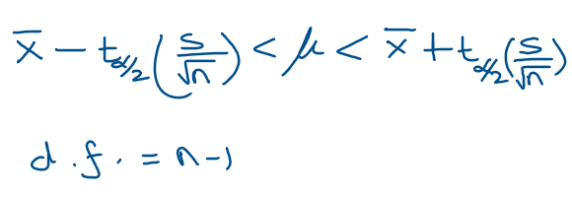
t-value
Formula for a Specific Confidence Interval for the Mean When σ Is Unknown
When σ is unknown and the sample size >= 30 , or the population is normally distributed if the sample size is less than 30, the confidence interval for the mean can be found by using the t distribution.

Slide 16
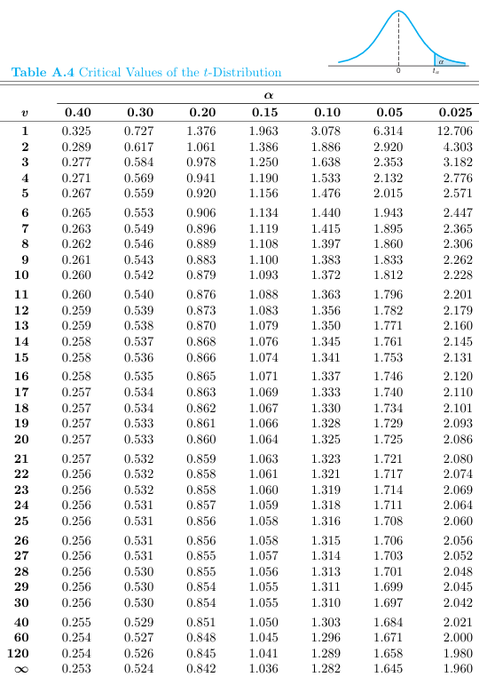
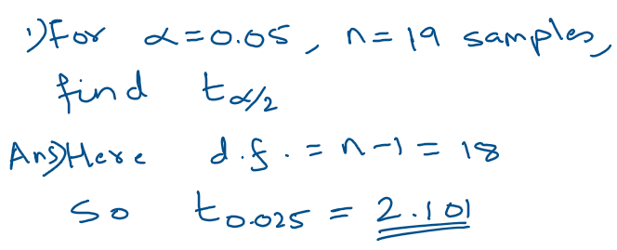
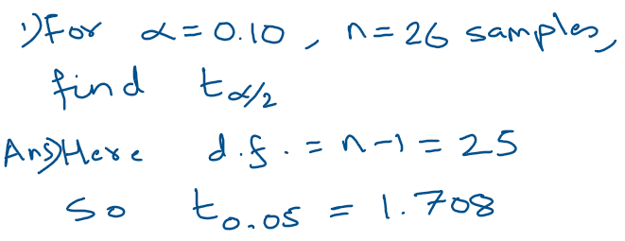
Steps to find t for a given alpha and sample size n

Slide 17
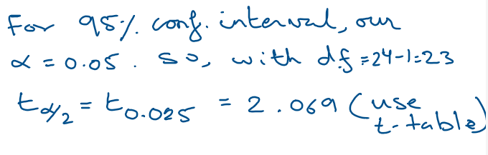
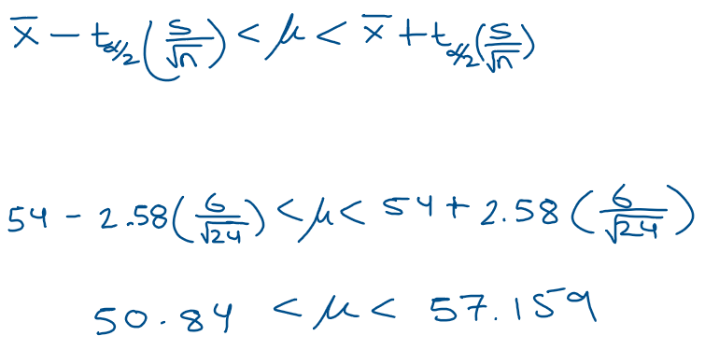
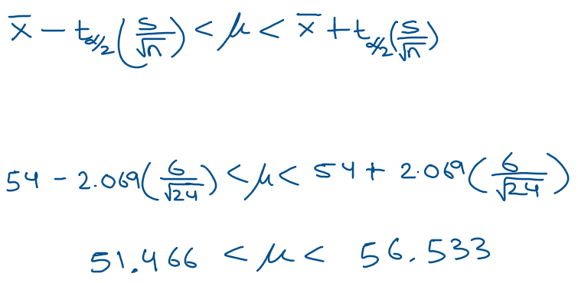
1) Engineering Measurement Problem (t - value): A quality control engineer wants to estimate the average time (in days) required to calibrate and certify a batch of precision measurement instruments in a laboratory. A random sample of 24 instruments showed an average calibration time of 54 days. Assume the samples standard deviation is 6.0 days.
Find the 95% confidence interval for the population mean calibration time.
Find the 99% confidence interval for the population mean calibration time.
Here we do not know σ, so we replace it with s, the samples std dev.
A) NOTE: we use t and not z table because the sample size, n < 30)
C) For the 99% confidence interval (i.e. α=0.01) use z=2.58 (from the z-table)
So, one can say with 95% confidence that the interval between 51.466 and 56.533 days does contain the population mean, based on a sample size of 24.
So, one can say with 99% confidence that the interval between 50.84 and 57.159 days does contain the population mean, based on a sample size of 24.

Slide 18
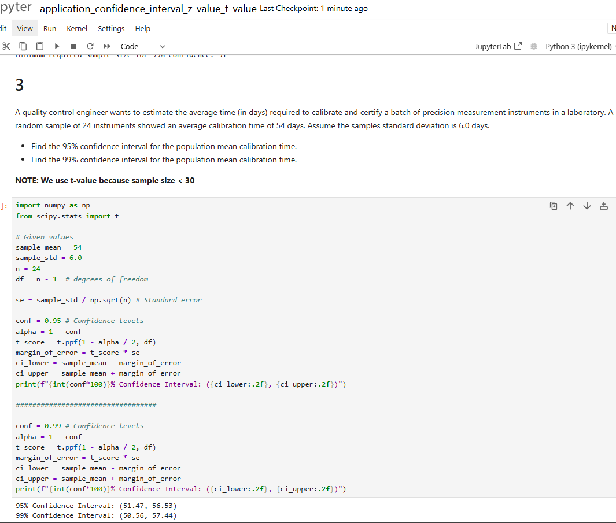

Slide 19
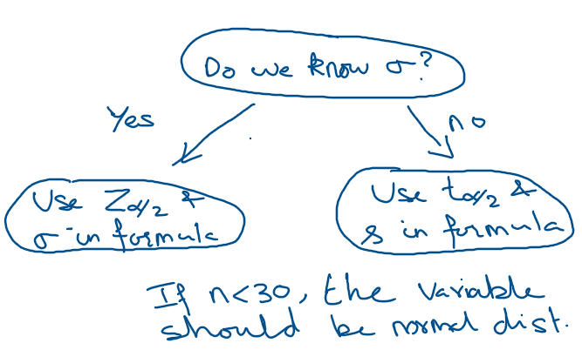
When to Use the z or t Distribution

Slide 20
Question: How do we know if a data is normally distributed?
See notebook: tut_ml/tut_statistics/tut_analysis_Normal_distribution_data_daily_bike_rentals.ipynb

